Slide 1

Programming with Python
Chapter 9

Slide 2
Introduction
Most modern computer software employs a graphical user interface or GUI
A GUI displays text as well as small images (called icons) that represent objects such as directories, files of different types, command buttons, and drop-down menus
In addition to entering text at keyboard, the user of a GUI can select an icon with pointing device, such as mouse, and move that icon around on the display

Slide 3
The Behavior of Terminal-Based Programs and GUI-Based Programs
Two different versions of the bouncy program from a user’s point of view:
Terminal-based user interface
Graphical user interface
Both programs perform exactly the same function
However, their behavior, or look and feel, from a user’s perspective are quite different

Slide 4
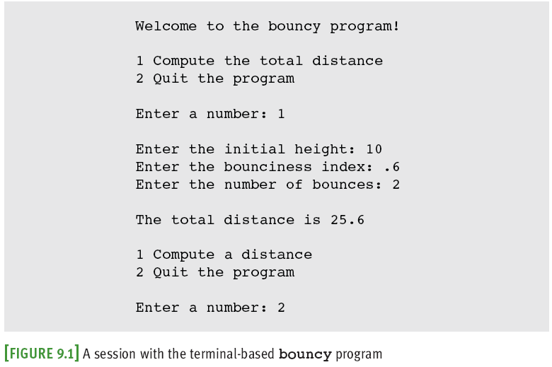
The Terminal-Based Version

Slide 5
The Terminal-Based Version
Problems:
User is constrained to reply to a definite sequence of prompts for inputs
Once an input is entered, there is no way to change it
To obtain results for a different set of input data, user must wait for command menu to be displayed again
At that point, the same command and all of the other inputs must be re-entered
User can enter an unrecognized command

Slide 6
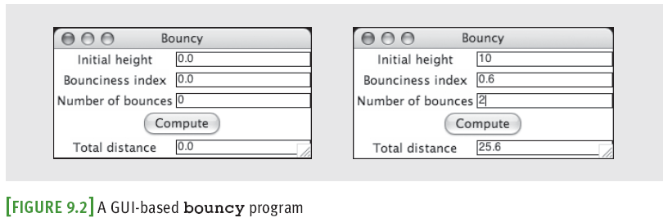
The GUI-Based Version
Uses a window that contains various components
Called window objects or widgets
Solves problems of terminal-based version
A label
An entry field
A command button
Title bar
Can be dragged to resize window

Slide 7
Event-Driven Programming
User-generated events (e.g., mouse clicks) trigger operations in program to respond by pulling in inputs, processing them, and displaying results
Event-driven software
Event-driven programming

Slide 8
Event-Driven Programming
Coding phase:
Define a new class to represent the main window.
Instantiate the classes of window objects needed for this application (e.g., labels, command buttons).
Position these components in the window.
Instantiate the data model and provide for the display of any default data in the window objects.
Register controller methods with each window object in which a relevant event might occur.
Define these controller methods.
Define a main function that launches the GUI.

Slide 9
Coding Simple GUI-Based Programs
There are many libraries and toolkits of GUI components available to the Python programmer
tkinter includes classes for windows and numerous types of window objects
tkinter.messagebox includes functions for several standard pop-up dialog boxes

Slide 10
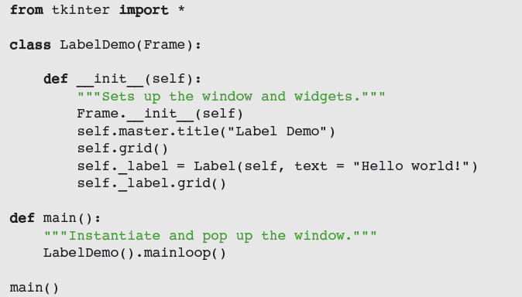
Windows and Labels
A grid layout allows programmer to place components in the cells of an invisible grid

Slide 11
Windows and Labels (continued)
The GUI is launched in the main method
Instantiates LabelDemo and calls mainloop
mainloop method pops up window and waits for user events
At this point, the main method quits (GUI is running a hidden, event-driven loop in a separate process)

Slide 12
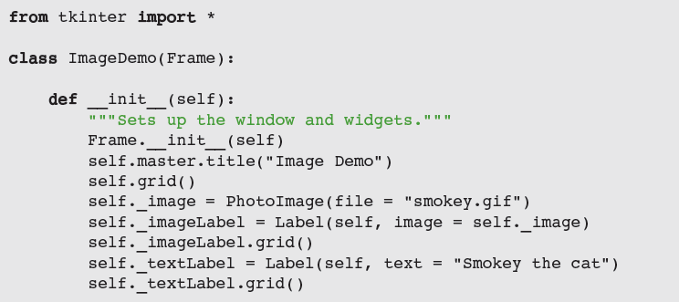
Displaying Images
Steps to create a label with an image:
__init__ creates an instance of PhotoImage from a GIF file on disk
The label’s image attribute is set to this object

Slide 13
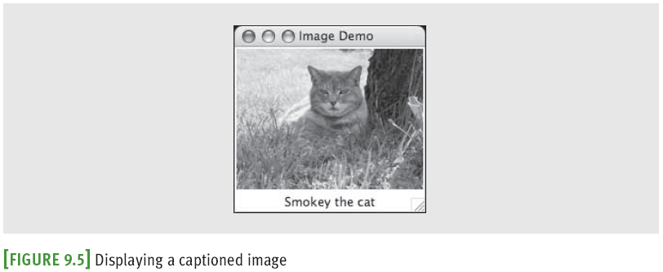
Displaying Images
The image label is placed in the grid before the text label
The resulting labels are centered in a column in the window

Slide 14
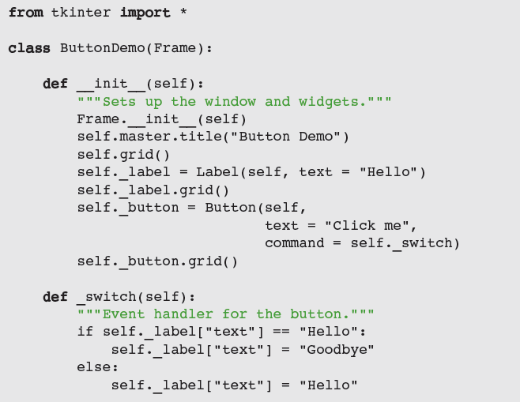
Command Buttons and Responding to Events

Slide 15
Command Buttons and Responding to Events
A button can display either text or an image
To activate a button and enable it to respond to clicks, set command to an event-handling method
In this case, _switch examines the text attribute of the label and sets it to the appropriate value
Attributes are stored in a dictionary

Slide 16
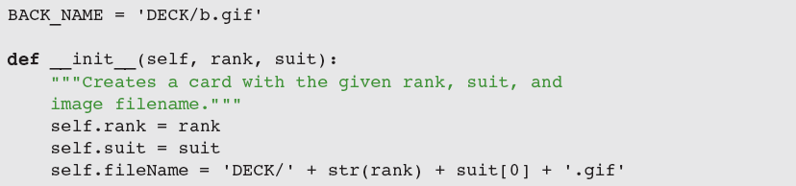
Viewing the Images of Playing Cards

Slide 17
Entry Fields for the Input and Output of Text
A form filler consists of labeled entry fields, which allow the user to enter and edit a single line of text
A field can also contain text output by a program
tkinter’s Entry displays an entry field
Three types of data container objects can be used with Entry fields:

Slide 18
Entry Fields for the Input and Output of Text

Slide 19
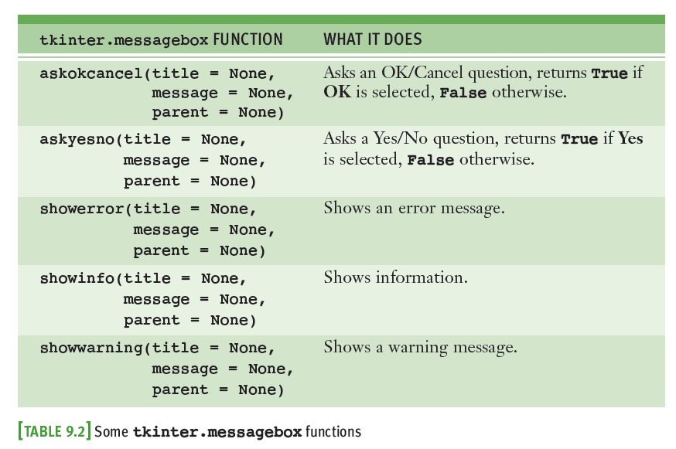
Using Pop-up Dialog Boxes

Slide 20
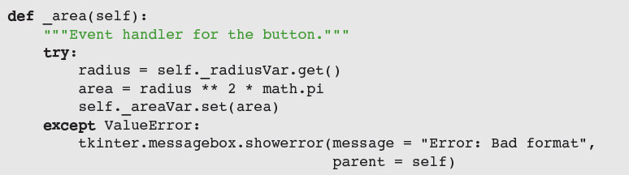
Using Pop-up Dialog Boxes

Slide 21
Case Study: A GUI-Based ATM
Request:
Replace the terminal-based interface of the ATM program with a GUI
Analysis:
There are no new classes, although the ATM class now extends the Frame class
Design:
Instead of implementing a text-based, menu-driven command processor, ATM now implements a GUI-based, event-driven command processor
_login and _logout

Slide 22
Case Study: A GUI-Based ATM

Slide 23
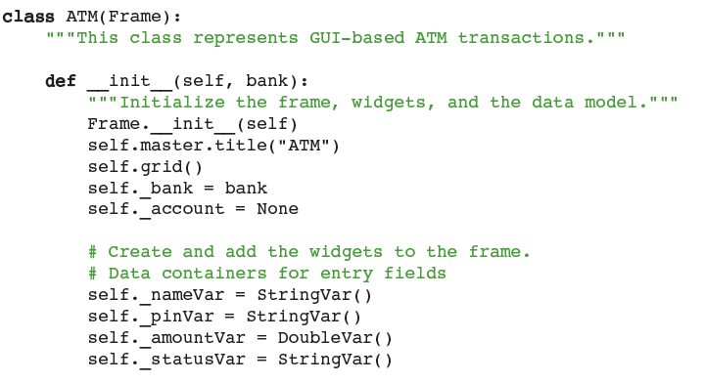
Case Study: GUI-Based ATM Implementation

Slide 24
Other Useful GUI Resources
Layout of GUI components can be specified in more detail
Groups of components can be nested in panes
Paragraphs can be displayed in scrolling text boxes
Lists of information can be presented for selection in scrolling list boxes and drop-down menus
Color, size, and style of text and of some GUI components can be adjusted
GUI-based programs can be configured to respond to various keyboard events and mouse events

Slide 25
Colors
tkinter module supports the RGB
Values expressed in hex notation (e.g., #ff0000)
Some commonly used colors have been defined as string values (e.g., "white", "black", "red")
For most components, you can set two color attributes:
A foreground color (fg) and a background color (bg)

Slide 26
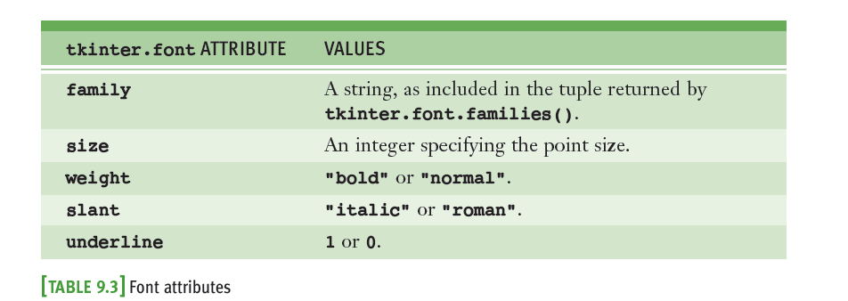
Text Attributes
The text displayed in a label, entry field, or button can also have a type font

Slide 27

Text Attributes Example

Slide 28
Sizing and Justifying an Entry
It’s common to restrict the data in a given entry field to a fixed length; for example:
A nine-digit number for a Social Security number

Slide 29
Sizing the Main Window
To set the window’s title:
self.master.title(<a string>)
Two other methods, geometry and resizable, can be run with the root window to affect its sizing
self.master.geometry("200x100")
self.master.resizable(0, 0)
Generally, it is easiest for both the programmer and the user to manage a window that is not resizable
Some flexibility might occasionally be warranted

Slide 30
Grid Attributes
By default, a newly opened window shrink-wraps around its components and is resizable
When window is resized, the components stay shrink-wrapped in their grid
Grid remains centered within the window
Widgets are also centered within their grid cells
Occasionally,
A widget must be aligned to left/right of its grid cell,
Grid must expand with surrounding window, and/or
Components must expand within their cells

Slide 31

Grid Attributes

Slide 32
Using Nested Frames to Organize Components
Suppose a GUI requires a row of command buttons beneath two columns of labels and entry fields:
It is difficult, but not impossible, to create this complex layout with a single grid
Alternative: decompose window into two nested frames (panes), each containing its own grid

Slide 33
Using Nested Frames to Organize Components
The new frame is then added to its parent’s grid and becomes the parent of the widgets in its own grid

Slide 34
Multi-Line Text Widgets
Use Text widget to display multiple lines of text
wrap attribute → CHAR (default), WORD, or NONE
Widget can expand with its cell; alternative: scroll bars
Text within a Text widget is accessed by index positions (specified as strings):
"rowNumber.characterNumber"
insert is used to send a string to a Text widget:
output.insert("1.0", "Pythonƒrules!")
output.insert(END, "Pythonƒrules! ")
delete can be used to clear a Text widget:
output.delete("1.0", END)

Slide 35
Multi-Line Text Widgets

Slide 36
Scrolling List Boxes

Slide 37
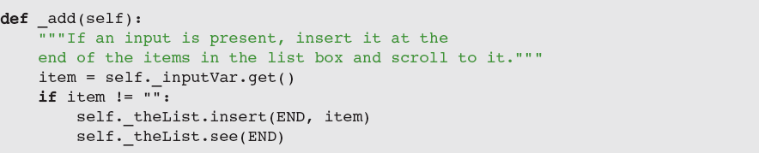
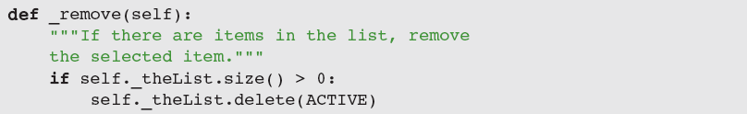
Scrolling List Boxes

Slide 38
Mouse Events

Slide 39
Mouse Events
Associate a mouse event and an event-handling method with a widget by calling the bind method:
self._theList.bind("<ButtonRelease-1>", self._get)
Now all you have to do is define the _get method
Method has a single parameter named event

Slide 40
Keyboard Events
GUI-based programs can also respond to various keyboard events:
Example: to bind the key press event to a handler
self._radiusEntry.bind("<KeyPress-Return>",
lambda event: self._area())

Slide 41
Summary
A GUI-based program responds to user events by running methods to perform various tasks
The model/view/controller pattern assigns the roles and responsibilities to three different sets of classes
tkinter module includes classes, functions, and constants used in GUI programming
A GUI-based program is structured as a main window class (extends the Frame class)
Examples of window components: labels, entry fields, command buttons, text areas, and list boxes

Slide 42
Summary
Pop-up dialog boxes display messages and ask yes/no question (tkinter.messagebox module)
Objects can be arranged using grids and panes
Each component has attributes for the foreground color and background color
Text has a type font attribute
The command attribute of a button can be set to a method that handles a button click
Mouse and keyboard events can be associated with handler methods for window objects (bind)

